Slide 1

How We Behave Matters
Team Session
Notes:
Notes for the colleague leading the session:
Before the meeting - Think about when and where you are meeting - circulate the framework ahead of the meeting, sharing the objectives for the session
Is there a big screen in your meeting room and do you need to order some printed copies of the framework?
During the meeting
1. Thank everyone for coming and ask for a volunteer to capture key points
2. Work through the slide pack and discussion questions, capture key points which can be shared with the team following the meeting
3. Whether the meeting is in person or virtual, make sure everyone is invited to comment and contribute
4. Be prepared to talk through specific cases outside the meeting, to ensure the group discussion stays constructive and positive
4. Agree how you will keep this a live agenda item in the months ahead
Post meeting
Share a summary of the key points discussed, including initial areas of strength, areas for improvement and the three actions the team has committed to
Use 121s to follow up on the group meeting, to gain more insight into how people are feeling about team relationships and behaviours
Start to role model giving feedback which references the behaviours outlined in the framework (both positive and unacceptable behaviours)

Slide 2

Psychologically safe space
We will listen to colleagues and ensure our voice is being heard
Explore with curiosity
We respect our values of Kind, Connected and Bold
Respecting confidentiality
Notes:
Explain how we want to work today - Psychologically safe space – (a belief that one will not be punished or humiliated for speaking up with ideas, questions, concerns or mistakes, based on the work of Professor Amy Edmonson – Harvad Business School)
To get the best out of the session, please limit distractions so we can fully engage. Ask for everyone to show agreement

Slide 3
Objectives for the session:
Understand what the Behavioural Framework is and why we need it
Understand the impact of your own and others behaviour at work
Make a personal commitment to role model the positive behaviours we love to see and reduce unacceptable behaviours
​

Slide 4
What is the Behavioural Framework?
Centred around our Kind, Connected and Bold values, the behavioural framework sets out what is expected in terms of both acceptable and unacceptable behaviours
The framework was co-designed with 1600 colleagues and launched April 24
Approach and language finalised with Wise Council member feedback
Internet page with resources and toolkits to support colleagues to have conversations about behaviours
Notes:
Naturally we will have differing views on what we think constitutes acceptable and unacceptable behaviours, and the framework clearly sets out the agreed standards whilst at work
If we are unsure, we can refer to the framework

Slide 5
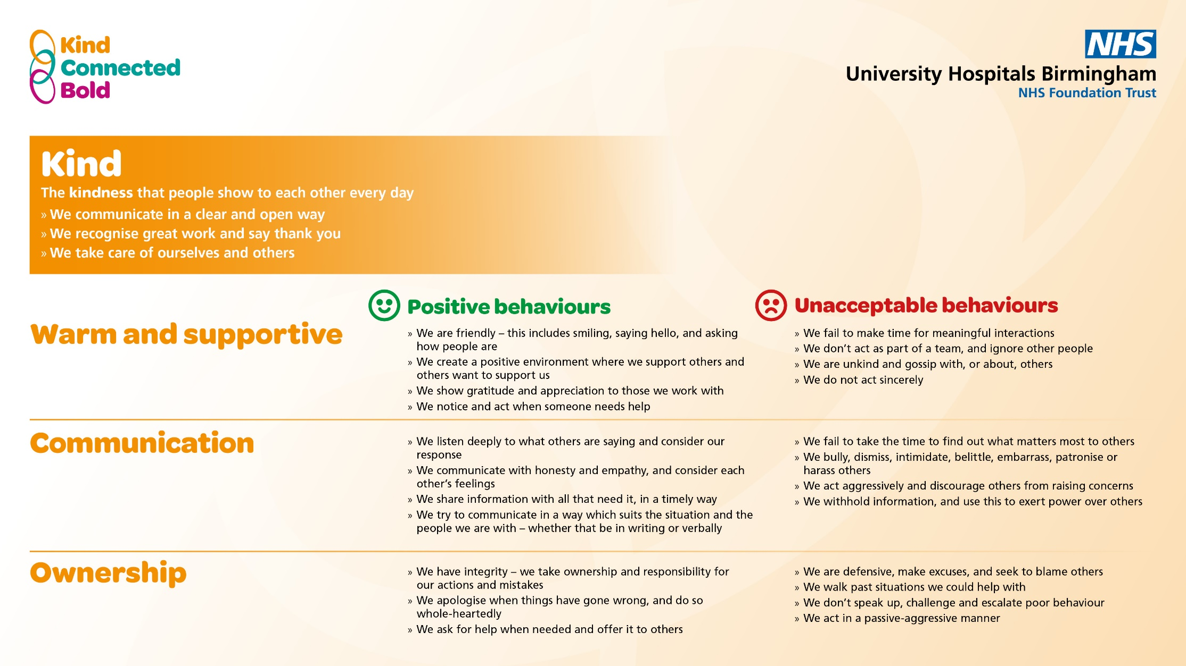
Notes:
Give everyone 10 minutes to read through the framework
Take feedback from the group - Initial thoughts and reactions

Slide 6
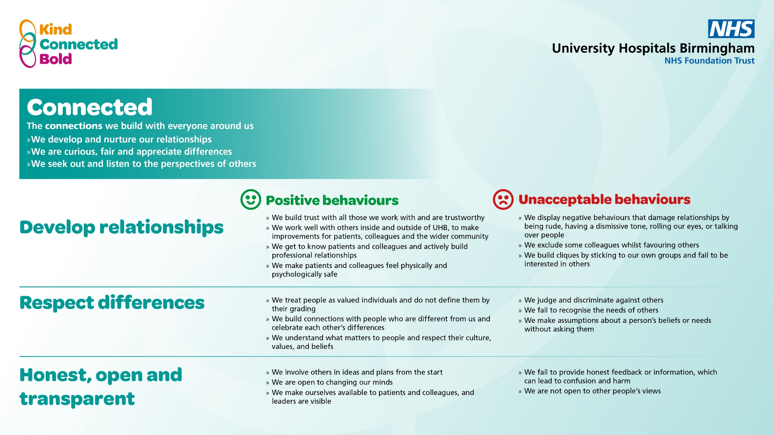

Slide 7
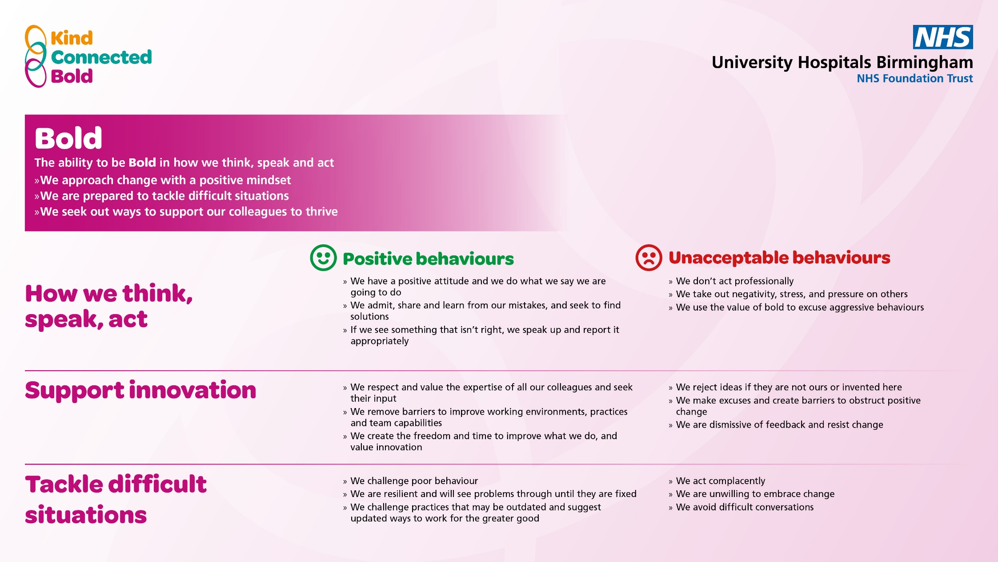

Slide 8
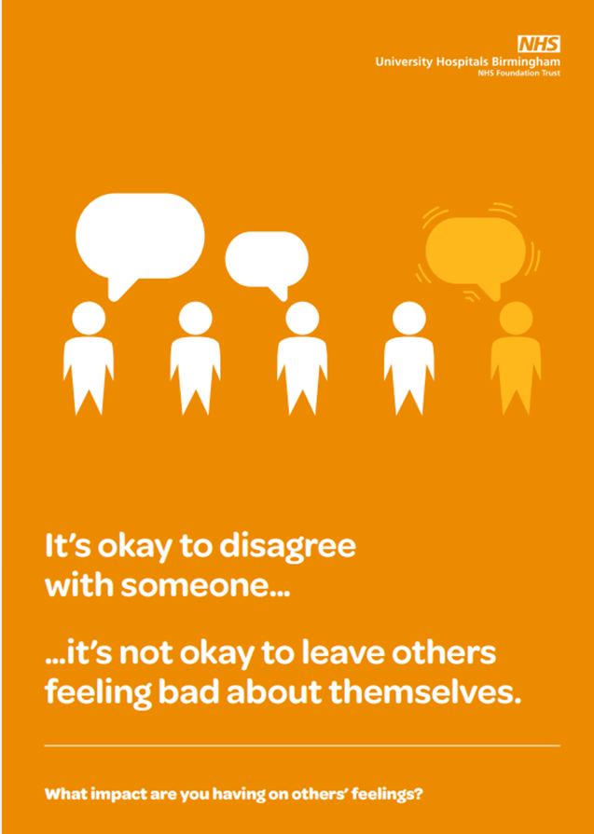
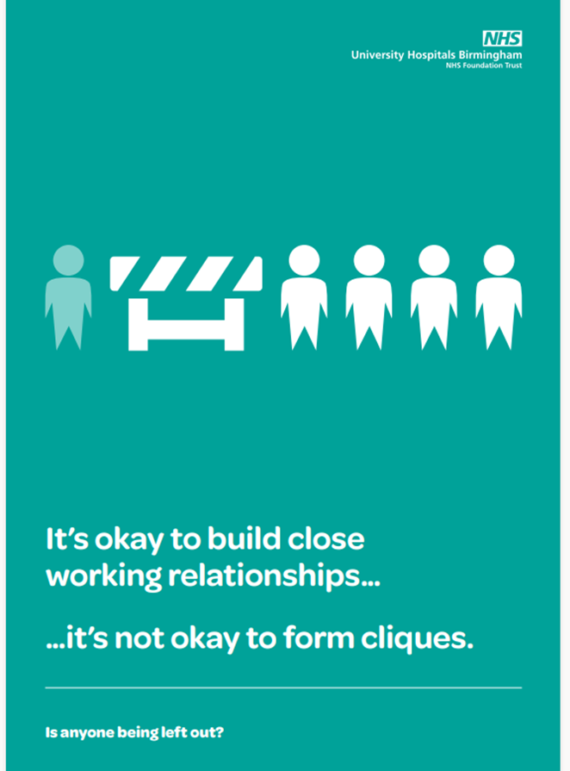
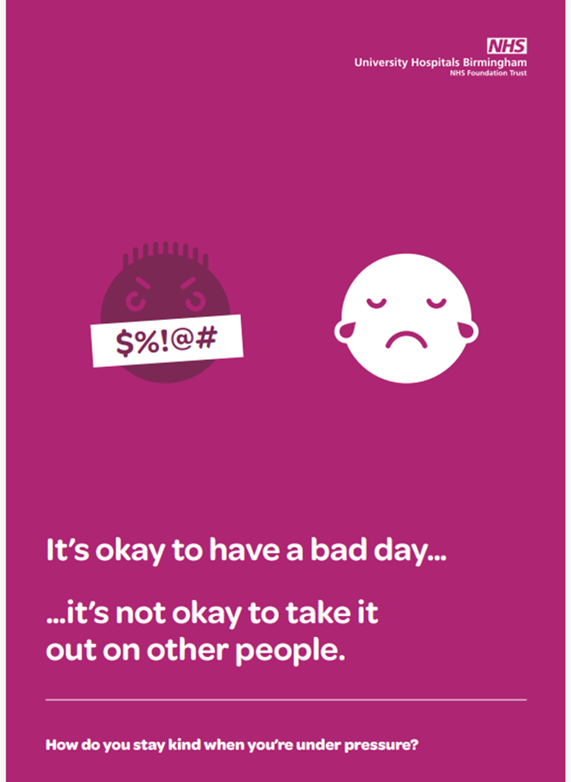
Notes:
This is our recently launched poster campaign, based on the work of researcher Brene Brown, It’s ok, it’s not ok posters, this framework helps us validate what others might be feeling and to bring some challenge, and also asks a prompt question. These are about bringing the framework to life and providing visual prompts

Slide 9
"Behaviours are still poor. Despite repeated complaints to my department's senior team nothing has changed. Communication within my team is also still extremely poor. It is really disappointing that despite completing these surveys with the same information each time, nothing changes locally"
HR colleagues have shared with us continued inappropriate behaviours, for example: shouting, entering altercations with colleagues, slamming doors, swearing, rude, disrespectful and aggressive communication​
Notes:
Our behavioural framework was introduced in April 2024, we've seen good initial traction with it, people starting to use it in conversations, and we know we still have a long way to go,
This is a comment from a recent staff survey – behaviours not aligning with values was the top survey theme from our July and April surveys
HR colleagues have shared with us - Inappropriate behaviours which are still coming through in HR cases– shouting, entering altercations with colleagues, slamming doors, swearing, rude, disrespectful and aggressive communication
The NHS is in a really difficult period at the moment, we are all feeling it, and when we are under pressure, being aware of our own behaviours has never been more important

Slide 10
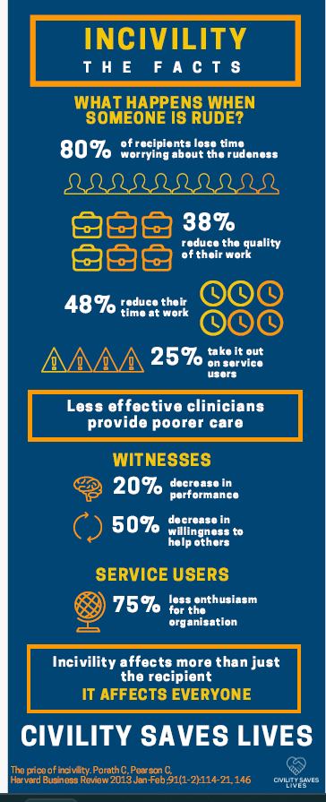
60 % reduction in cognitive function
63 % lose time avoiding the person
12 % leave their job because of it
Notes:
Research from the Harvard Business review – is central to the civility saves live campaign, which I'm sure many of you will have heard of
So, what happens when someone is rude? – 80% spend time worrying about it, quality of work, people go home early, 25% take out on colleagues / service users
Ripple effects - and those witnessing it are impacted, patient advocacy reduces

Slide 11
How unacceptable behaviours
can show up...
Notes:
Now going to look at the ways unacceptable behaviours can show up at work – we've talked about some of the more obvious examples of things coming through our HR cases – swearing, shouting etc, now spend some time looking subtle and frequent ways

Slide 12
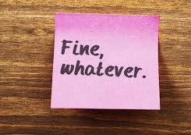
Patronising language
Silent treatment
Back-handed compliments
Sarcasm
Evading issues
Moody behaviour
Notes:
“Passive aggression is a way of expressing negative feelings, such as anger or annoyance, indirectly instead of directly”
These are some of the ways that passive aggression can show up, in the words and behaviour. These can be some of the harder ones to address

Slide 13
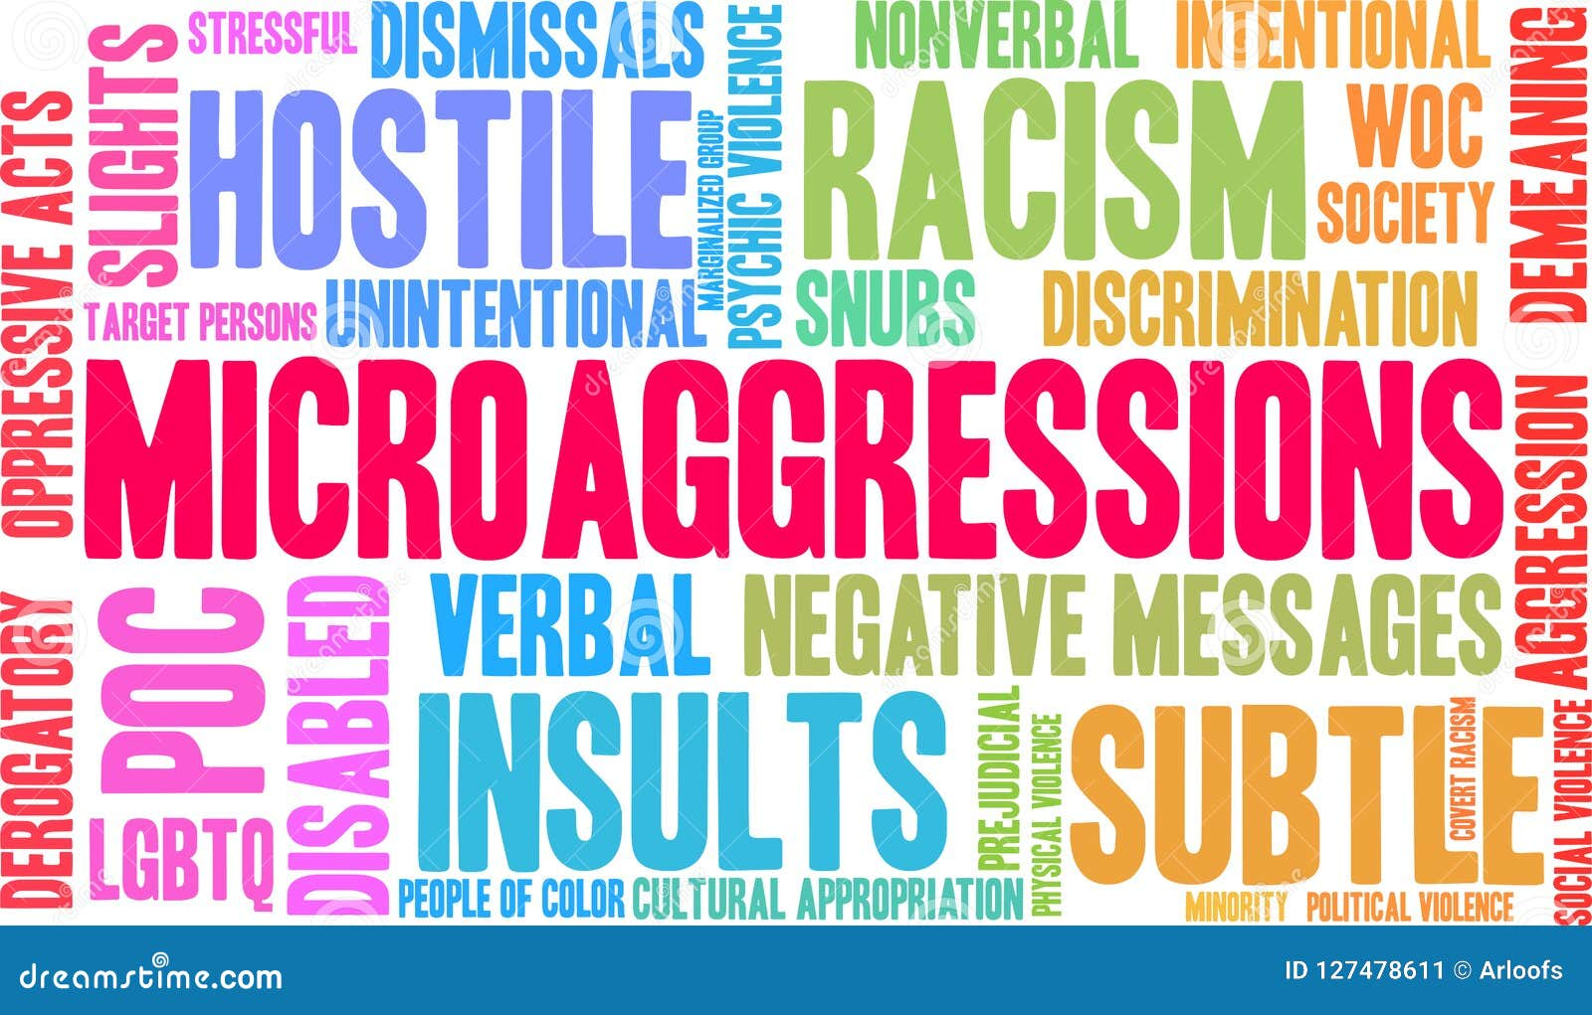

Notes:
Microaggressions - intentional or unintentional comments that communicate hostility or negative attitudes toward marginalised groups.
Your unconscious biases could be - race, gender, age, religion, nationality or sexuality. We are always having an impact on others, whether or not we realise it

Slide 14

Notes:
Banter is the playful and friendly exchange of teasing remarks
Banter is only banter when everyone is laughing. People won’t always feel confident to speak up if they are offended by something. They might even go along with it so as not to draw attention to themselves. It can be very excluding and alienating or inclusive and being part of a clique. Third parties might be offended, even if they’re not part of your conversation

Slide 15
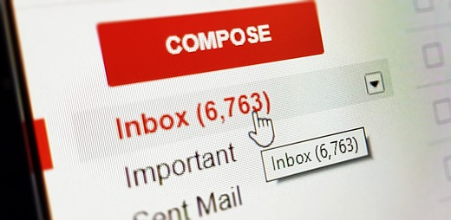
Notes:
Emails! How many times have we been upset / frustrated / fuming by an email – or email trail?
Can be easily misunderstood and create unnecessary conflict
Poor behaviours in email can look like:
Unnecessary use of colours or FONTS, copying in the world, passive aggressive language
Lack of basic manners, using email as a weapon, writing an email when you have strong emotions
Complaining, gossiping or blaming
Note of caution - our emails are releasable under FOI as is teams chat

Slide 16
Talk with the person next to you about these two questions, then feedback to the group and answer question three
1. Where do you think we are strong in terms of positive behaviours?
2. In what areas would you like to see improvements in terms of unacceptable behaviours?
3. Based on the feedback, agree three actions your team will commit to, to support improvements in team behaviours
Notes:
We’re going to spend some time thinking about how can we use this in our team and how could it help improve team relationships and ways of working
Talk through the exercise on the slide.
We want the feedback here to be general, rather than specific (e.g. “I’d like to see less rudeness and dismissive behaviours”, rather than ‘I’d like Alice to stop being rude to Abdul”)
The aim of this discussion is to raise awareness of areas the team feel could be improved, and gain commitment from colleagues to think about how they could improve in the areas raised.
Some people may not feel comfortable to answer these questions in a group forum, which we understand and respect. This is the start of the process and we hope and expect confidence in talking about behaviours to strengthen over time.
Take feedback from the group (use chat and raised hands if on teams). Based on the feedback, agree three actions your team will commit to, to support improvements in team behaviours.
We want the feedback here to be general, rather than specific (e.g. “I’d like to see less rudeness and dismissive behaviours”, rather than “I’d like Alice to stop being rude to Abdul”)

Slide 17
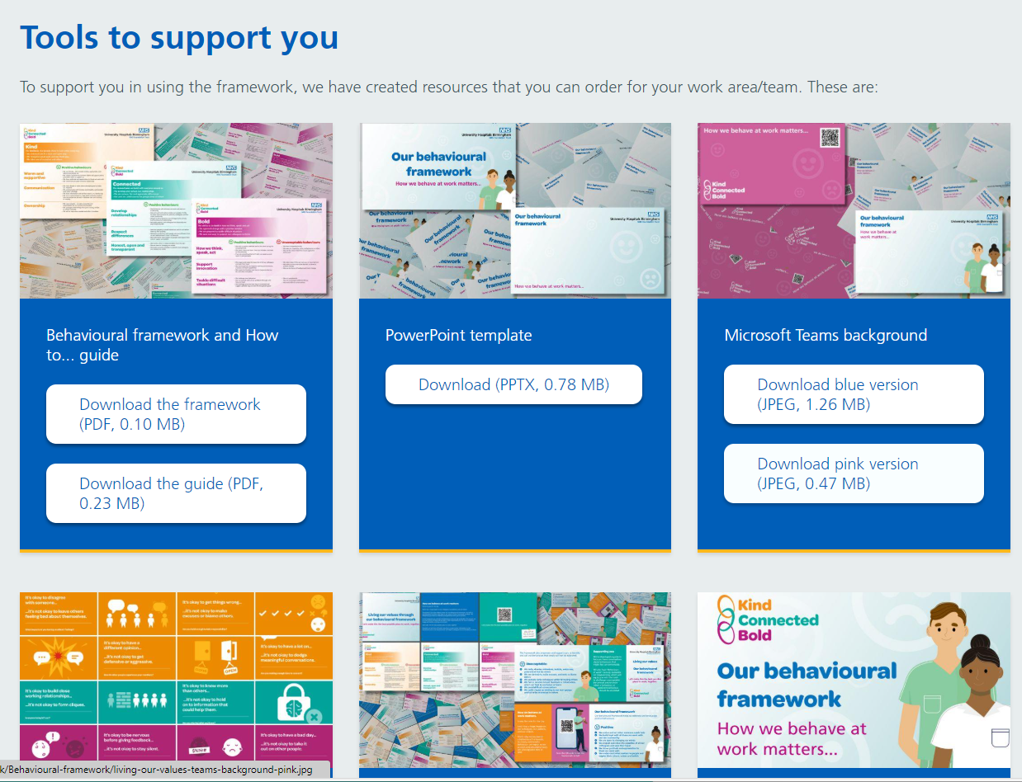
New website with resources for download and order:
Teams background
How to guide
Posters
Notes:
Our new internet site has downloads and materials to order from our print room – including copies of the framework, pocket size guides, Poster campaign based on the work of Professor Brene Brown – It’s okay, its not okay, Teams background (available in pink and blue) really effective to use and prompt people to reflect on their behaviours
https://www.uhb.nhs.uk/living-our-values-uhb-s-behavioural-framework/

Slide 18
Take aways
What action will you personally commit to?
How can you use the framework to improve how your team works together?
How can you help spread the word!
If you are a leader, book onto the How We Behave Matters workshop
Notes:
How can we keep these conversations live? When will be revisit? How can we use the framework to improve team meetings?
Start small and build your confidence in talking about behaviours

